Slide 1

Lecture 3
Software Design and Architecture
Rana Taimur Khan
Lecturer GCUF

Slide 2
Software Design Coupling
Coupling:
The measure of dependency between modules and components.
The degree of interdependence between two modules and components.

Slide 3
Software Design Coupling
A dependency exists between two modules/components if a change in one could require a change in the other.
Coupling is inter-component relationship.

Slide 4
Software Design Coupling
Measuring Coupling:
The degree of coupling between modules is determined by:
The number of interfaces between modules (Quantity).
Complexity of each interface (determined by the type of communication) (Quality).

Slide 5
Software Design Coupling
Why high degree coupling is bad?
Highly coupled systems have strong interconnection.
High dependence of program units upon one another.
Due to high dependence, there is difficulty in testing, reuse and understand separately.
Loosely coupled modules are less dependent upon each other and hence are easier to change.

Slide 6
Software Design Coupling
We aim to minimize coupling to make modules as independent as possible.
Low coupling can be achieved by:
Eliminating unnecessary relationships
Reducing the number of necessary relationships.
Easing the “tightness” of necessary relationship.

Slide 7
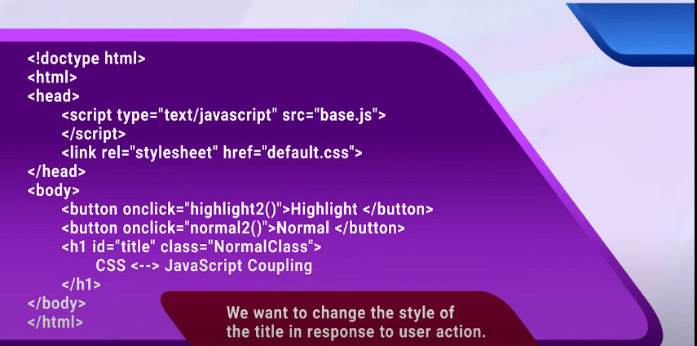
Coupling Design of a simple web app

Slide 8
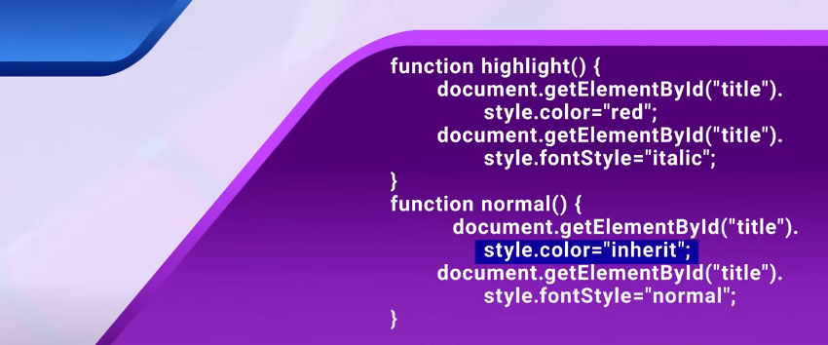
Coupling Design of a simple web app
Option A:
JavaScript code modifies the style attribute of HTML element.

Slide 9
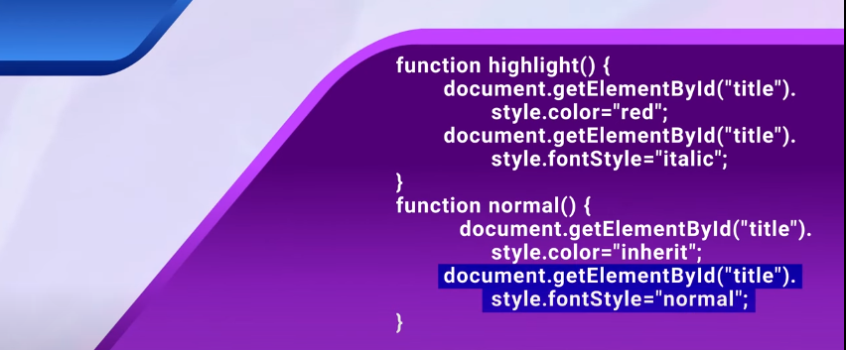
Coupling Design of a simple web app
Option A:
JavaScript code modifies the style attribute of HTML element.

Slide 10

Coupling Design of a simple web app
Option A:
JavaScript code modifies the style attribute of HTML element.

Slide 11
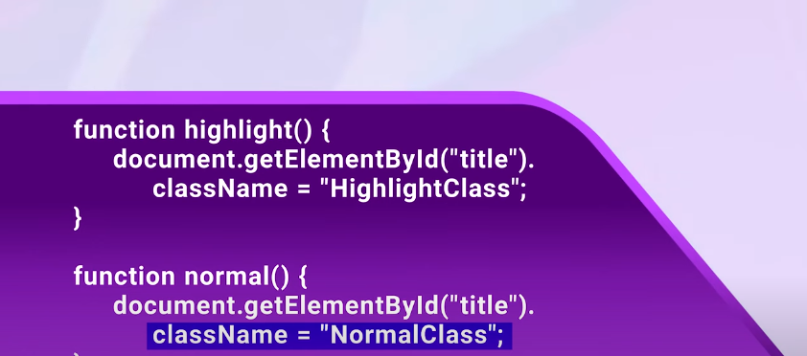
Coupling Design of a simple web app
Option B:
JavaScript code modifies the class attribute of HTML element.

Slide 12
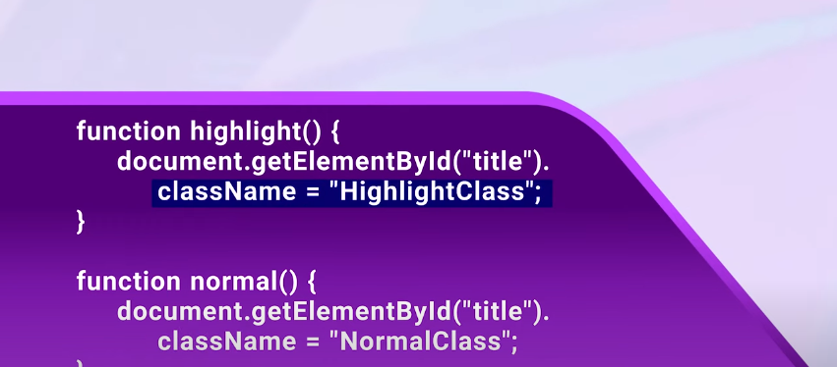
Coupling Design of a simple web app
Option B:
JavaScript code modifies the class attribute of HTML element.

Slide 13

Coupling Design of a simple web app

Slide 14

Coupling Design of a simple web app

Slide 15
Coupling Design of a simple web app
Option B is better because in this case we have reduces the coupling

Slide 16
Software Design Cohesion
Cohesion:
Refers to the degree to which the elements inside a module belong together.
A Measure of the strength of relationship between:
The methods and data of a class and some underlying purposes or concept served by that class
And
Class’s methods and data themselves.

Slide 17
Software Design Cohesion
A module has high cohesion if all of its elements are working towards the same goal..

Slide 18
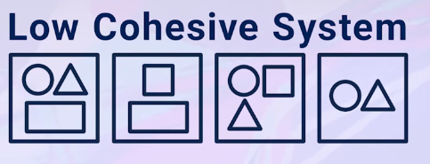
Software Design Cohesion

Slide 19
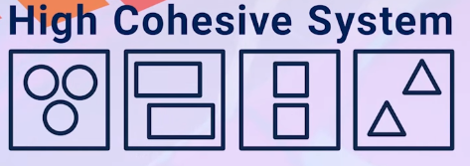
Software Design Cohesion

Slide 20
Software Design Cohesion
Highly Cohesive Modules:
Easier to Understand
More Robust
More Reliable
More Reusable

Slide 21
Software Design Cohesion
Lowly Cohesive Modules:
Difficult to Understand
Difficult to Maintain
Difficult to test
Difficult to reuse

Slide 22
Software Design Coupling and Cohesion Relationship
Highly Cohesive Modules:
Easier to read and understand
Easier to modify
Increase potential for reuse
Easier to develop and test

Slide 23
Software Design Coupling and Cohesion Relationship
Lowly Coupled Modules:
Easier to read and understand
Easier to modify
Increase potential for reuse
Easier to develop and test

Slide 24
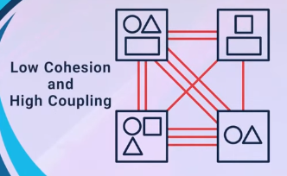
Software Design Coupling and Cohesion Relationship

Slide 25
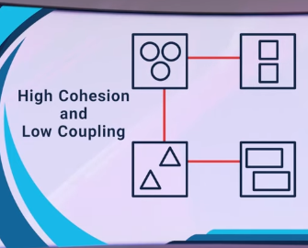
Software Design Coupling and Cohesion Relationship

Slide 26
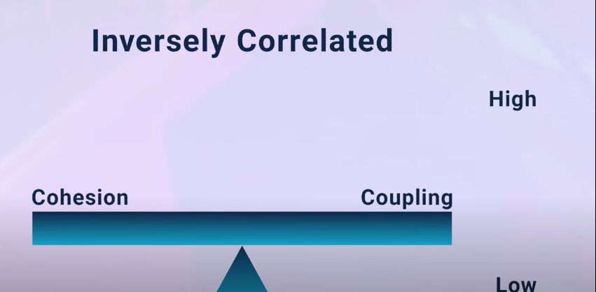
Software Design Coupling and Cohesion Relationship

Slide 27
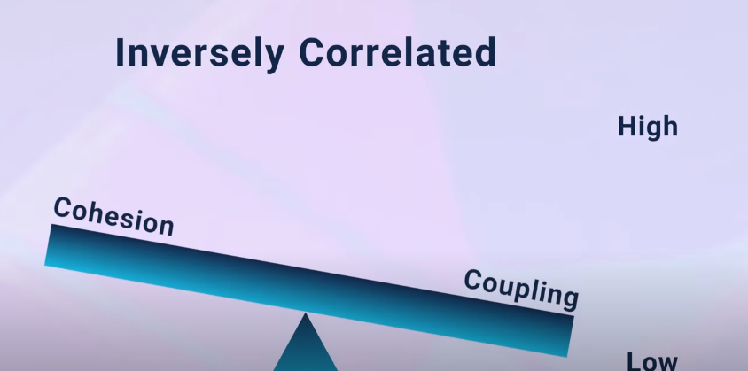
Software Design Coupling and Cohesion Relationship

Slide 28
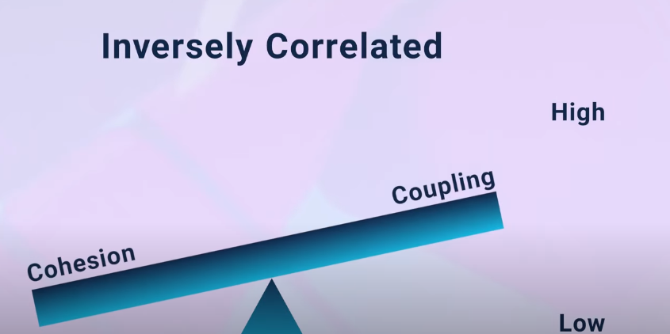
Software Design Coupling and Cohesion Relationship

Slide 29
Software Design Coupling and Cohesion Relationship
Cohesion:
Intra-module relationship
Coupling
Inter-module relationship
So, the best designs have high cohesion within a module and low coupling between modules.

